Slide 1
MATH 241 Recitation
10-16-19

Slide 2
AGENDA
CHECK IN
GENERAL ANNOUCEMENTS
REVIEW
GROUP Q & A 5 minutes
WORKSHEETS
CHECKOUT

Slide 3
GENERAL ANNOUNCEMENTS
Check out with the LA only if you need to leave earlier than scheduled
If you want to check your current hours: email Professor Anne Carter
atcarter@hawaii.edu
Next week Thursday and Friday is the retake for Exam 1
November 8 is Exam 2

Slide 4
Intermediate Value Theorem
CONDITION
Curve is a function
Continuous within the interval [a, b]
Therefore there is a solution w is a number between f(a) and f(b)
https://www.mathsisfun.com/algebra/images/intermediate-value-a.svg

Slide 5
FUNCTION TO BE DIFFERENTIABLE
Take the derivative of the given function
If there is a derivative then it is differentiable
EXAMPLE
Show that f(x) = 5x is differentiable.

Slide 6
Derivative
If you want the slide from Tuesday email saitoshi@hawaii.edu

Slide 7
HINTS ON THE WORKSHEET

Slide 8
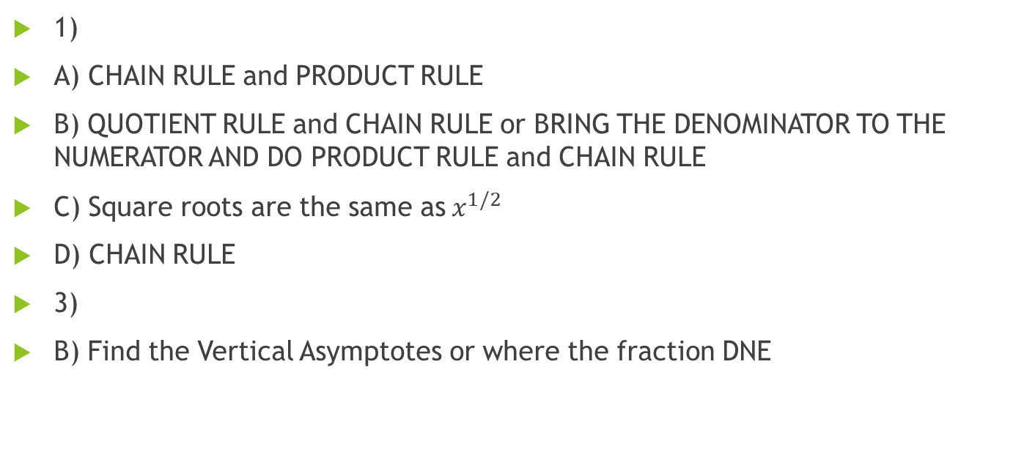
HINTS
1)
A) CHAIN RULE and PRODUCT RULE
B) QUOTIENT RULE and CHAIN RULE or BRING THE DENOMINATOR TO THE NUMERATOR AND DO PRODUCT RULE and CHAIN RULE
C) Square roots are the same as$x^{1/2}$
D) CHAIN RULE
3)
B) Find the Vertical Asymptotes or where the fraction DNE

